Slide 1



Music Machine Learning
IV – Probabilistic models
Master ATIAM - Informatique
Philippe Esling (esling@ircam.fr)
Maître de conférences – UPMC
Equipe représentations musicales (IRCAM, Paris)

Slide 2

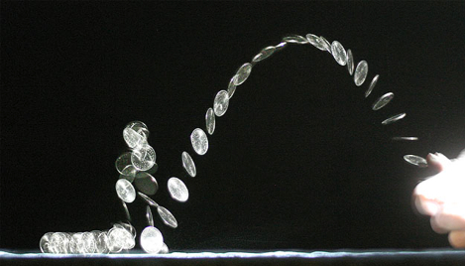

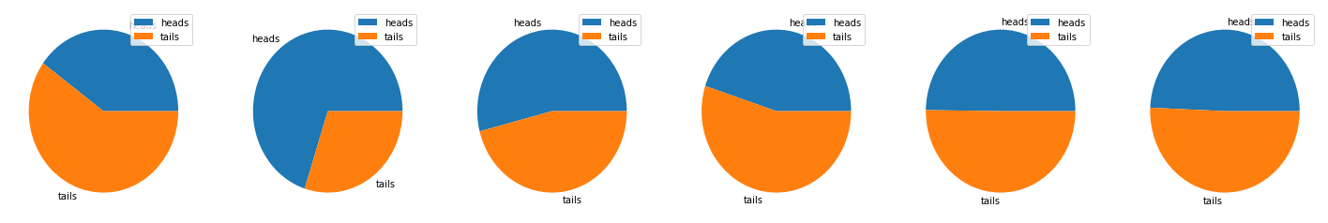
Understanding probability
We can witness events that appear uncertain or random
Typical example of tossing a coin or rolling a die
Events that appear random (too complex)
If we had access to all variables
We might predict exactly the outcome
Say we observe a set of samples
For instance, we can throw our coin a very large number of times
Each throw is independent (appears random)
But we can expect some behavior on the distribution of all throws
5 throws
10000 throws

Slide 3
Probability - terminology
Experiment (or trial)
Action with an uncertain outcome
Sample space
set of all possible outcomes of an experiment
Sample point
a single possible outcome in the set
Event (or sample)
outcome of single instance of an experiment
Probability: value that indicates the likelihood of a particular event
: event is impossible
: event is inevitable
…
Allows to define the three axioms of probability

Slide 4
Probability - terminology
The three axioms of probability
For any event
Probability of the sample space
For a set of disjoint events , we have
Going back to our example of coin tossing, we have
The probability of having heads or tails is
Note also that
The probability of having heads and tails is
These events are said to be disjoint

Slide 5
Basic probabilities
Recalling our basics
Imagine that we have two random events and
Intuition: notion of space
« Probability of landing in the circle »
area of the circle divided by area of space
Space of possibilities
Probability of landing anywhere in the space
Probability of landing on infinitesimal point
If we add the
two areas, we
see that the
intersection
is counted twice
Space of our coin toss

Slide 6
Conditional probability
Imagine that we have two random events with a dice
: Getting a 6
: Getting an even number
Now if we observe , it changes the probability of
This is expressed by the conditional probability
Conditional probability:
So it is the probability of
If we restrict the world of possibilities to

Slide 7
Conditional probability
Definition:
Chain rule

Slide 8
Independence
Imagine that we have two random events with a dice and a coin
: Getting a 6 on the dice
: Getting heads with the coin
Observing will supposedly not influence
Definition:
independent of

Slide 9
Conditional independence
Definition:

Slide 10
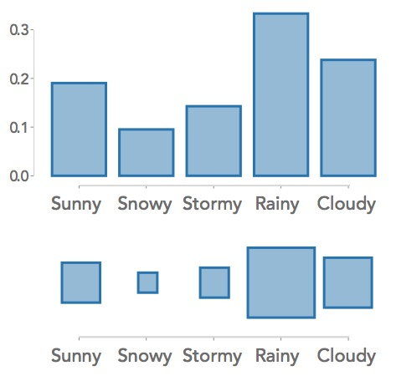
Random variables
Definition
A random variable is a function that maps events from the sample space to a measurable space
Notion of distribution
Discrete random variable
Defined on a countable set of discrete values
Follows a probability mass function (pmf)
Continuous random variable
Defined on a continuous domain
Follows a probability density function (pdf)

Slide 11
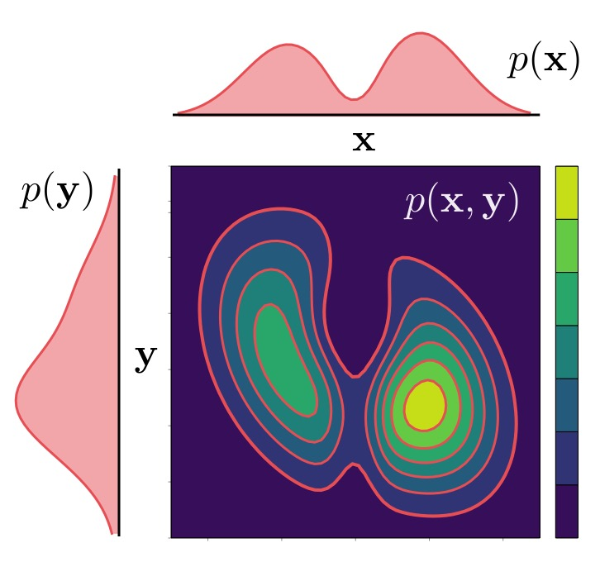
Joint probability and marginalization
If we consider two random variables and
We can observe their paired outcomes.
This is defined as their joint probability distribution
If we consider a set of random variables
Given the joint distribution
We can retrieve through marginalization
Marginal distributions

Slide 12
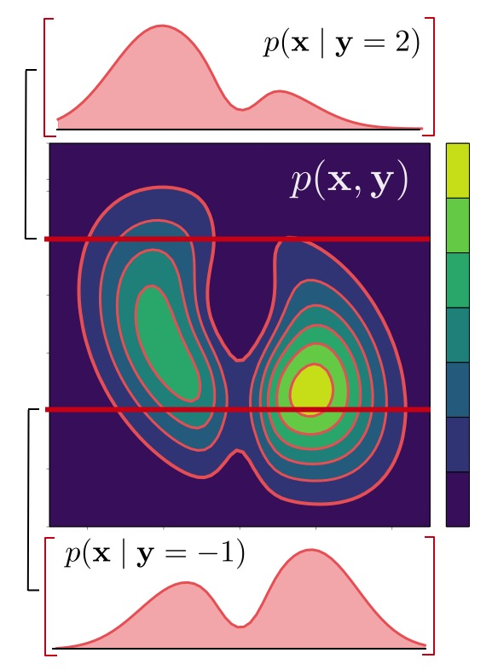
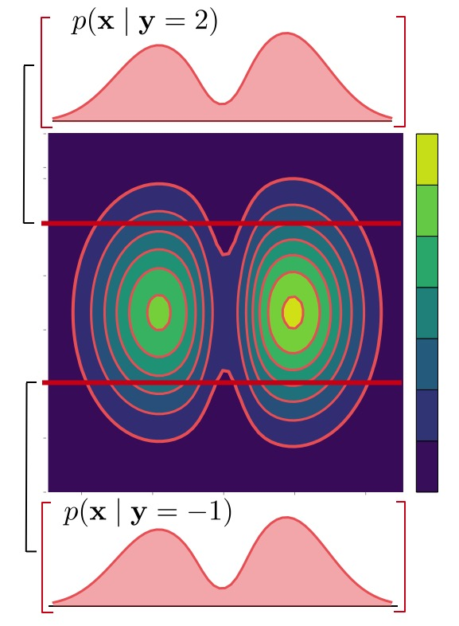
Conditional probability and independence
The conditional probability of given
Explains how behaves if we observe
As discussed before, we have
Note that this becomes a function of
Two random variables and are said to be independent if
This also implies that

Slide 13
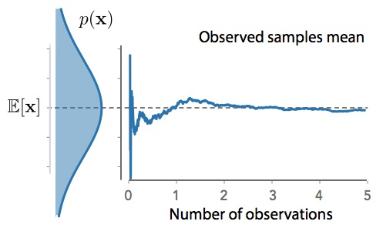
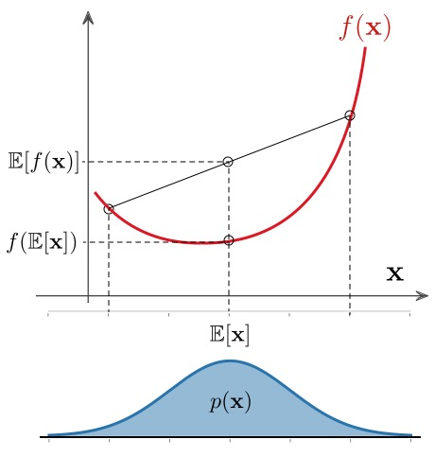
Expectation and inequalities
If is a random variable with distribution
Then its expectation is given by
The discrete equivalent is
This defines the expected value
(see the central limit theorem)
Useful properties of the expectation
Linearity
Cauchy-Schwarz
Jensen inequality
If is a convex function

Slide 14
Continuous distributions : Normal (Gaussian)
A continuous random variable follows a Normal distribution of mean and variance , noted if we have
Different parameters for the Gaussian
Attractive properties of the Gaussian (Normal) distribution
Unimodal and symmetric distribution
Stable by linearity : if then
Density is infinitely differentiable
Mathematical simplicity

Slide 15
Continuous distributions (Multivariate Normal)
A continuous random variable follows a multivariate Normal distribution of mean and covariance , noted if we have
Understanding parameters
Different types of covariances
Independent
(mean-field)
Full covariance
Isotropic
Also a whole set of attractive mathematical properties

Slide 16
Continuous distributions bestiary
Exponential distribution
Gamma distribution
Beta distribution

Slide 17
Probabilistic Graphical Models
Imagine that we need to express a complicated joint probability
Very complex for a large number of variables
Hard to understand the independence structure of our problem
Entering the world of probabilistic graphical models
Graphs endowed with a probability distribution
Nodes represent random variables
Edges encode conditional (in)dependence
Graphical model express sets of conditional independence
Depending on the structure of the graph
Graph structure + variables = joint probability distribution

Slide 18
Probabilistic Graphical Models
Two main flavors of graphical models
Directed graphical models (Bayes nets, Belief nets)
Set of nodes with directed edges between them
Arrows encode conditional probability distributions
Undirected graphical models (Markov random fields)
Set of nodes with undirected edges between them
Absence of edges show conditional independence
Each type of model serves a different purpose
Usually directed version for defining learning models
Some independences are impossible to represent in directed
Also some process are awkward to represent in directed ones
For the time being, we will only discuss the directed
Note that we come back to undirected models later

Slide 19
Probabilistic Graphical Models

Slide 20
Directed graphical models
In directed models, each node represent a random variable
The edges show local conditional probability densities
For instance, we can express the following joint distribution
More formally, a directed model represent
The factorization of a joint distribution as a set of conditional distributions
Given a set of nodes , we have the following
Where denotes the parent of node

Slide 21
Probabilistic inference
Let say that you have a dog
If a raccoon shows up, your dog will bark
If a burglar shows up, your dog will bark
If I want to know the probabilities …
I need to build a table and keep the counts
So how big of a table do I need to keep?
B
R
D
Seen
T | T | T
T | F | T
F | T | T
F | F | T
T | T | F
T | F | F
F | T | F
F | F | F
|
||
|
|
||||
.1
.2
.05
.1
.01
.09
.05
.4

Slide 22
Belief network
Let say that you have a dog
If a raccoon shows up, your dog will bark
If a burglar shows up, your dog will bark
The raccoon will not show up as the dog is barking
The burglar will not show up as the dog is barking
So the causality flows from the raccoon and the burglar to the dog
So we can make a diagram of this
B
R
Given its parents every node is independent
of all other non-descendents
But B might depend on R (explaining away)
D
T
Racoons can make the
trashcans fall
Eg. Calling the police depends
solely on the probability of the dog
P
You can call the police
(causality flows in)
How big is the probability table I need if I want to keep the tallies ?

Slide 23
Belief network
0.1
B
R
0.5
D
T
F | 0.01
T | 0.8
F | F | 0.1
T | F | 1.0
F | T | 0.5
T | T | 1.0
P
F | 0.01
T | 0.5
We only had to specify 10 numbers instead of 32 !
The use of belief nets (Bayes nets) alleviates the full table
As the table grows exponentially …
But we still need this full table to perform calculations !

Slide 24
Belief network
We devise the belief net to represent causality
Very important property of belief nets … There is no loops
So we can work from the bottom and go up
B
R
D
T
P
D
B
T
R
P
Now we are sure that no descendent are on the left …

Slide 25
Explaining away
Let’s look closer to a sub-problem of this
B
R
D
"Explaining away" is a common pattern of reasoning in which the confirmation of one cause of an observed or believed event reduces the need to invoke alternative causes
If D and B are true, the probability of R decreases
Nodes are conditionnaly dependent on parents of their descendants

Slide 26
Joint probability table
Let’s look closer to a sub-problem of this
is true
All
B
R
|| | |||
D
is true
A priori probability of B
All
Experimental observations
T | T
T | F
F | T
F | F
| | ||
 | |
T T T
F F F
T T F
By making experimental observations, we update probabilities
By going to infinity, we approximate the real probabilities

Slide 27
Joint probability table
But what we want is to create a model
So imagine that we filled in all probabilities tables
B
R
FLIP COIN
[F]
FLIP COIN
[T]
D
T | T
T | F
F | T
F | F
FLIP COIN
So here we have an experimental trial
But of course this depends if the model is right

Slide 28
Naïve Bayes inference
But someone says you got it all wrong
You start with a model
B
R
B
R
D
T
D
T
P
P
So how could we decide which one is right ?
World of naïve Bayes inference

Slide 29
Learning
What about probabilities in machine learning ?
Supervised learning is inferring a function from labeled training data
Unsupervised learning is trying to find hidden structure in unlabeled data
We can define any problem as
So we first need to define what function could approximate this process
Then we need to evaluate the « quality » of this approximation
Problem space
Solution space
How can we model uncertain (or creative) problems ?

Slide 30


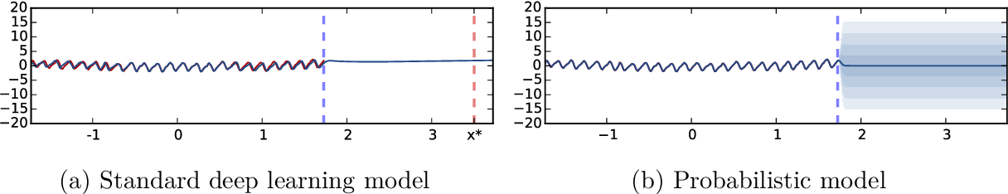
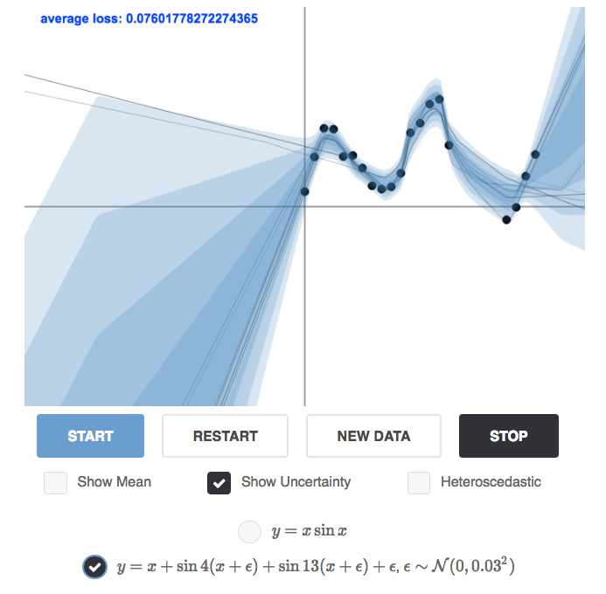
Probabilistic machine learning
Consider data
following a distribution
Sampling new individuals
Now how to define (discriminative) learning ?
Looking for the answer given the input
Why ?
Handling uncertainty

